Slide 1
Laser Target-Shooting
Group 6
Cameron Vo – Optical Engineering
Eltholad Orelien – Electrical Engineering
David Johnson – Electrical Engineering
Quang Pham – Computer Engineering
Notes:
David Johnson
Hello. We are Group 6, and our project is the “Laser Target-Shooting.” Our members are Cameron Vo, Eltholad Orelien, David Johnson, and Quang Pham.

Slide 2
Motivation
Live Firearms
Expensive, inconvenient, dangerous, and harmful for the environment
Airsoft
Quite expensive and still harm the environment
Lack some features of real guns such as recoil
Lasers
Decreased danger, environmental impact, and ammunition cost
Portability and accessibility increased
David Johnson
Electrical Engineering
Notes:
David Johnson
When planning this project, we were mainly motivated by how to simulate a shooting range experience to train your shooting skills and gun safety while making them more safe and consumer friendly.
Compared to using live firearms and airsoft, we believe that lasers can provide a safe and realistic alternative for training

Slide 3
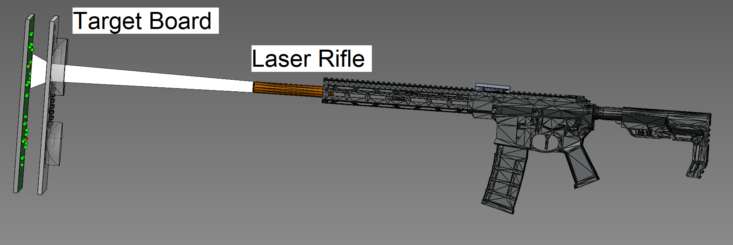
Goals
Create a laser-target shooting system that gives immediate feedback to where a shot is made via LEDs
Portable system usable in both broad daylight and nighttime
Implement features to simulate real firearms (recoil, gunfire, etc)
Develop smartphone app to control system for customizability
David Johnson
Electrical Engineering
Notes:
David Johnson
Our main goals of this project are to create a working laser-target shooting system that gives visible feedback to your shot placement using LEDs. It will need to be portable and usable in extreme lighting conditions such as broad daylight and midnight. It will include many features that will be customizable and controlled using our smartphone app

Slide 4
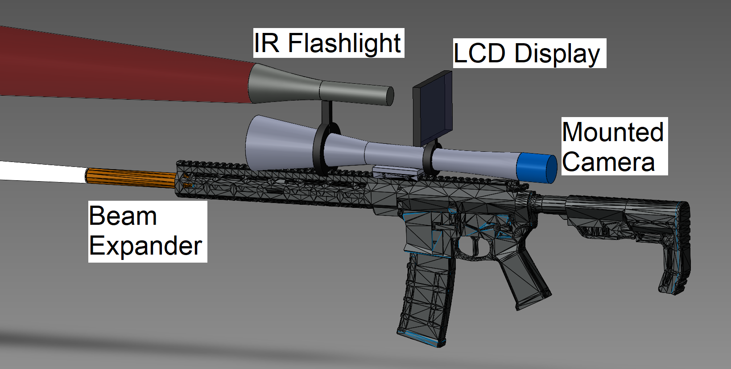
Objectives - Rifle
Battery-powered
Frequency modulated IR laser diode
Spot size controlled by beam expander
Pairs to smartphone app via Bluetooth
Customization of features i.e. gunfire sounds
Software-based magazine and ammo system
Variable Power Rifle Scope
Removable Night Vision System
IR Flashlight, CMOS Camera, LCD Display
David Johnson
Electrical Engineering
Notes:
David Johnson
Our main objectives are split into the rifle and target board. For the rifle, we plan on using batteries to power the whole system. There will be an IR laser diode that will be frequency modulated with a beam expander installed to control spot size. The rifle will pair to smartphones using Bluetooth to control features and keep track of the rifle’s status. We will also create a custom variable power rifle scope that will come with a removable night vision system

Slide 5
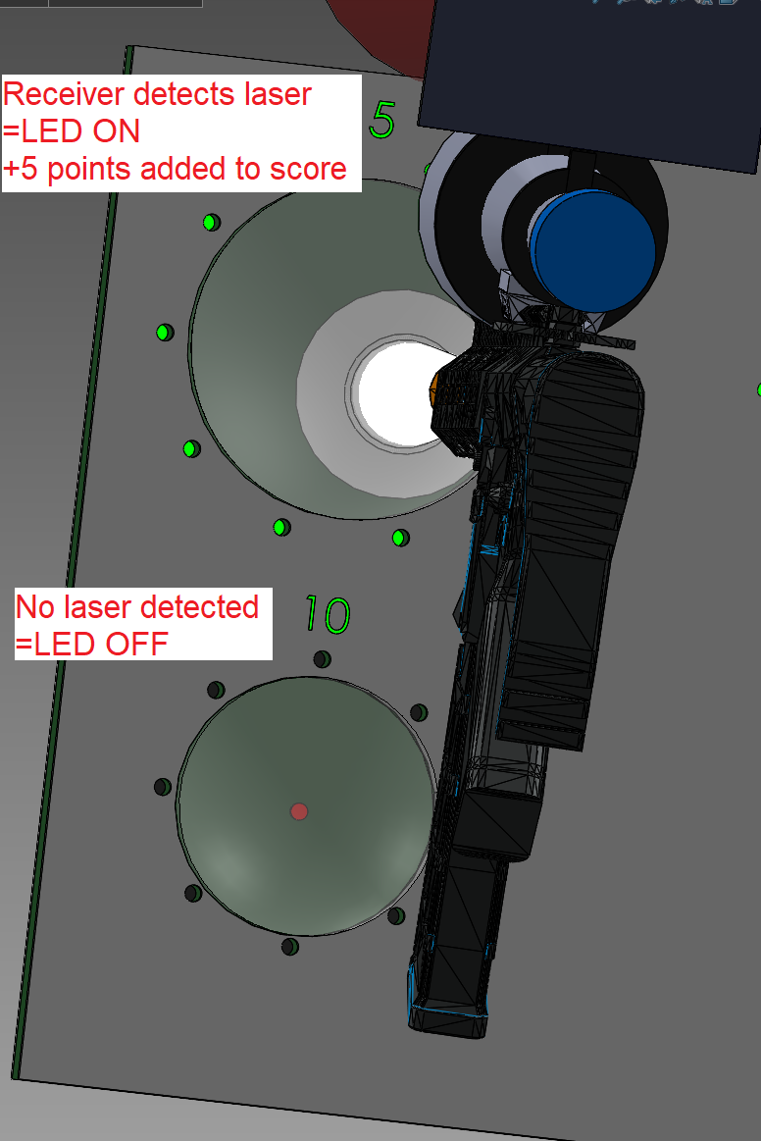
Objectives - Target Board
IR Receivers
Only detects modulated light at the IR laser frequency
LEDs
Lights up when the laser is detected by a receiver
Built-in Concave Lenses
Reduce optical noise and expand the beam further
Pairs to smartphone app with Bluetooth
Keeps track of score
Different game modes
David Johnson
Electrical Engineering
Notes:
David Johnson
For the target board, we will use IR receivers, which are basically photodiodes that will only detect light modulated at a specific frequency within its spectral range. LEDs will light up when the target is hit by the laser and provide visible feedback. There will also be a built-in concave lens apart of the target board, to reduce optical noise and expand the beam further to reduce the amount of IR receivers needed. The target board pairs to the smartphone app via bluetooth and keeps track of the user’s score and allows for different game modes.

Slide 6
Requirement ID | Requirement/Specification
1.0 | The system will not exceed 10 lbs with all internal components. | 5 - 10 pounds
1.1 | The system will be pairable with a phone through Bluetooth and be recognized by the mobile app. | Bluetooth 5.0 or Bluetooth Low Energy
1.2 | The system will be powered by batteries that can be recharged with a compatible plug. | 9V Lithium Battery(s)
1.3 | The system needs to perform at the shortest time interval between the pulling of the trigger and the visual response of the target. | < 1 second
1.4 | The system controller should use power efficiently. | Efficiency > 30%
1.5 | The system should be in “ready for use” state within a short time after startup. | < 1 minute
1.6 | The system should have the controller stay running at a high uptime. | > 4 hours
1.7 | The system should operate without overheating. | < 50 °C
1.8 | The system will include a mountable variable-power rifle scope with high resolving power | > 3.5x max magnification <0.15 mrad angular resolution
1.9 | The system will be able to fully function at a long distance between the rifle and target board. | >15m
1.10 | The system will emit a laser beam that has low divergence such that it can be used accurately at long ranges. | <1.5 mm per meter (1.5 mrad)
1.11 | The system will output a laser spot size that is small enough to ensure accurate shot placement on the target board. | <40 mm at 15m target distance
1.12 | The system will emit a laser beam that is considered low-risk for eye safety. | Class 3R (<5 mW)
1.13 | The system will use a 3D printed target board that is large enough to be clearly visible at long ranges while also being portable | > 12 in x 12 in < 10 lbs
Notes:
David Johnson
This slide will detail our Requirements Specifications for our project.
Along with all of our requirements, we have also highlighted 3 possible candidates for testing in our demo. The system should be able to provide visible feedback to the user in as short of a time period as possible. The system will also need to be able to be fully functioning within the designated start-up time. The system will also need to fully work at at least 15m away.

Slide 7
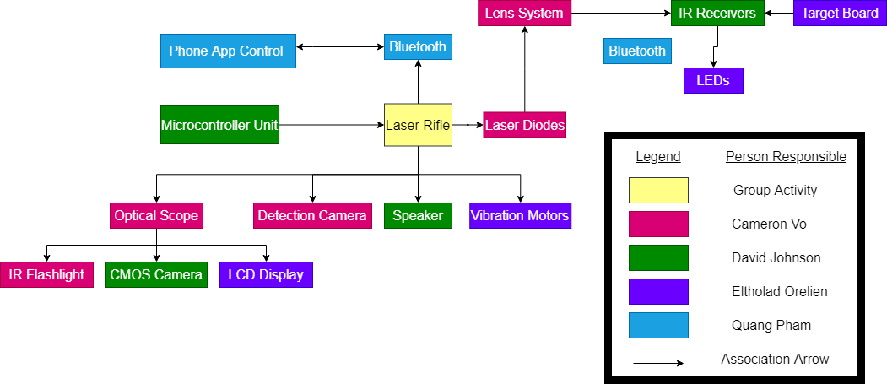
Hardware Block Diagram
Quang Pham
Computer Engineering
Notes:
Quang Pham
This is our hardware block diagram, which gives a basic overview of all hardware aspects of this project and how they interact with each other. It also shows the role of each member in the project.

Slide 8
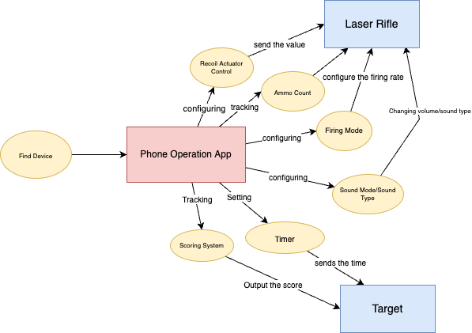
Software Block Diagram
Quang Pham
Computer Engineering
Notes:
Quang Pham
This is our visual illustration of the mobile operational application system that represents a few concepts that our group member have decided for. In this block diagram, The mobile app will pair with our Laser Rifle and the Target board app feature that we named as FIND DEVICE which is basically using the Bluetooth technology to connect them. The app will configure the recoil actuator of the rifle, track the ammo count of the rifle, configure and modify the firing mode in any way a user desires. Users can start a game on the app and the scoring can be viewed by connecting the app to our Target device.

Slide 9
Software Design Tools: Mobile Application
Tools | Features
Figma | Multiple devices screen size
Arduino IDE | built-in libraries and example codes. Open source.
Visual Studio Code | Built-in support for development applications. Great extensions to customize the edit-build-debug experience.
React Native Framework | Open source, reusability components, similar structures to React JS
Quang Pham
Computer Engineering
Figma
Notes:
Quang Pham
our software design is the mobile application development. Our team design User Interface are using wire frames from Figma. Figma has all features necessary for the app development. Our group favorite feature is the multiple phone model screen presets that we use to view our current UI on those mobile phone.
React Native is an open source framework for building Android and iOS applications using React and the app platform’s native capabilities. You will hear more about React Native in the next slide.
We then choose VS Code as our primary code editor because it includes enriched built-in support for development applications that make extensive use of the ability to run Javascript both on a client as well as the server, and this is called Node.Js. And then we chose Arduino IDE to flashing programming code onto our designed Microcontroller Unit.

Slide 10
Software Design Approach and Implementation
Quang Pham
Computer Engineering
Technologies | Supported Operating Systems | Features | Coding Language | Cost
Flutter | Android & iOS | Open source, multi-platform, rich widgets | Dart | Free
React Native | Android & iOS | Open Source, and multi-platform. Reusable components | Javascript, Typescript | Free
XCode | iOS | Easy to learn Syntax, native on Apple platform, and Open source. | Swift | Free
Android Studio | Android | Open source, native on Android platform, and well optimized for Android apps. | Java, Kotlin | Free
Notes:
Quang Pham
This is slide is about our software design approach for mobile application. We are decided to use React Native because it’s compatibility with multiple devices. Both Android & iOS. We like the Reusability code feature. What it means we create our components, define what they need to be used and then port them in any code. Minimizing a lot of duplicate code by simply sharing logic across web and mobile versions. Our team member is also familiar with the React js code and we like that React Native has a similar structure to the React JS.

Slide 11
Rifle Design Approach and Implementation
Rifle serves as the main device for users
User interface and system control is done through mobile app
Additional Subsystems:
2 main buttons (reload & trigger)
Laser Diode
Haptic feedback
Eltholad Orelien
Electrical Engineering
Notes:
Eltholad Orelien
The rifle in our system acts as the primary device for the user –while will users configure settings through a mobile app that will provide things like game information and data tracking. As such, ergonomics, user experience, and reliability are important while designing this device.
The additional subsystems that are required for this device are the additional buttons (ie reload switch trigger), the laser diode and haptic feedback. These components will work together to create a familiar rifle experience

Slide 12
Target Design Approach and Implementation
Similar hardware approach to reduce complexity
MCU, audio and power
Targets are slightly more passive elements
Mostly responds to game coordination commands from Controller
Additional Subsystems
IR receiver / Laser Detection
LED target indication
Eltholad Orelien
Electrical Engineering
Notes:
Eltholad Orelien
It was our plan to maximize similarities in the hardware design of both rifle and target systems to reduce complexity: By using the same audio system, microcontroller and power subsystem
As a target normally would, the target board in the system will act in a more passive role – It will simply listen for either messages from the users phone or the excitation of a laser, then act upon that. Because of this, it isnt as computationally active and are somewhat simpler in their design.
The target board does have some additional subsystems, however – the IR receivers for laser detection, and a LED array to serve as a visual indicator during gameplay.

Slide 13
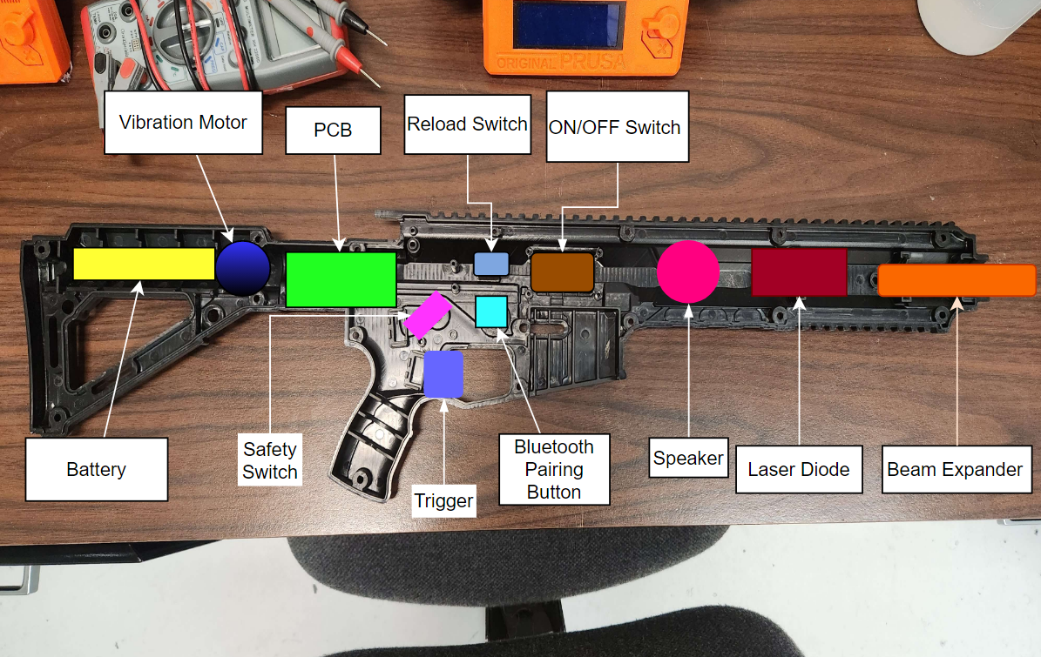
Rifle Enclosure Implementation
Cameron Vo
Optical Engineering
Notes:
Cameron Vo
This image shows how we will implement our rifle enclosure. We purchased the frame and made this diagram to show where each component will be placed. The rifle frame came with various physical parts such as safety switches that we will also implement into our design

Slide 14
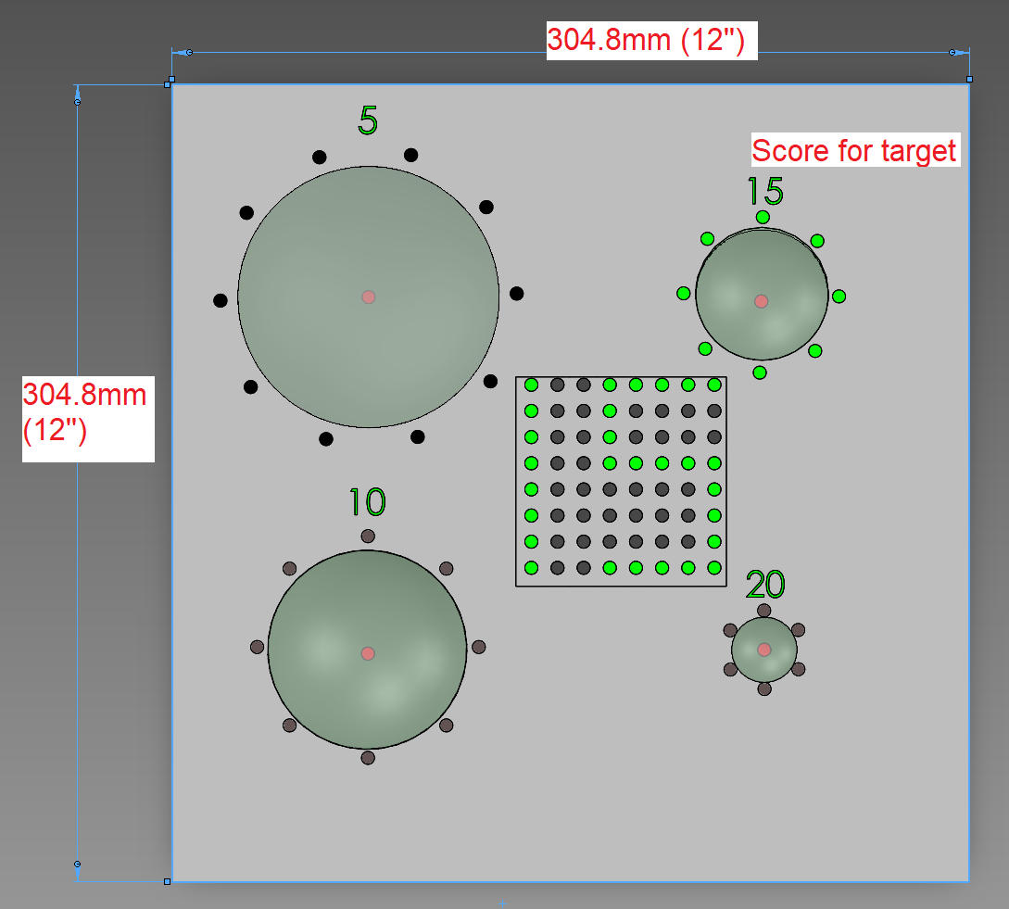
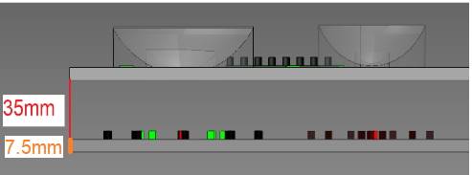
Target Board Implementation
Entirely 3D printed with two separate front and back panels
Lenses are printed separately and will be fixed into place
Board will be spray painted using glossy white paint
Increases light reflectivity for use with IR flashlight
Cameron Vo
Optical Engineering
Front Plane
Cross Section
Interaction With Laser
Notes:
Cameron Vo
We plan on 3D printing the entirety of the target board. It will be 12 inch by 12 inch in size and will contain a back piece and front piece that will be screwed together. The lenses will be printed separately and fixed into place on the front piece, directly covering the IR receivers on the back piece. Although they are included in the pictures, we are still deciding on how LEDs will actually be implemented in the final design. The board will also be spray painted using glossy white paint to increase light reflectivity, increasing the effectiveness of the IR flashlight.

Slide 15
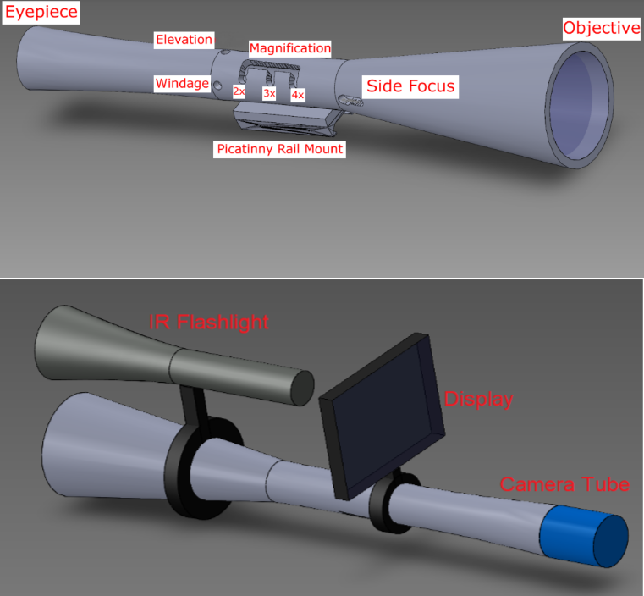
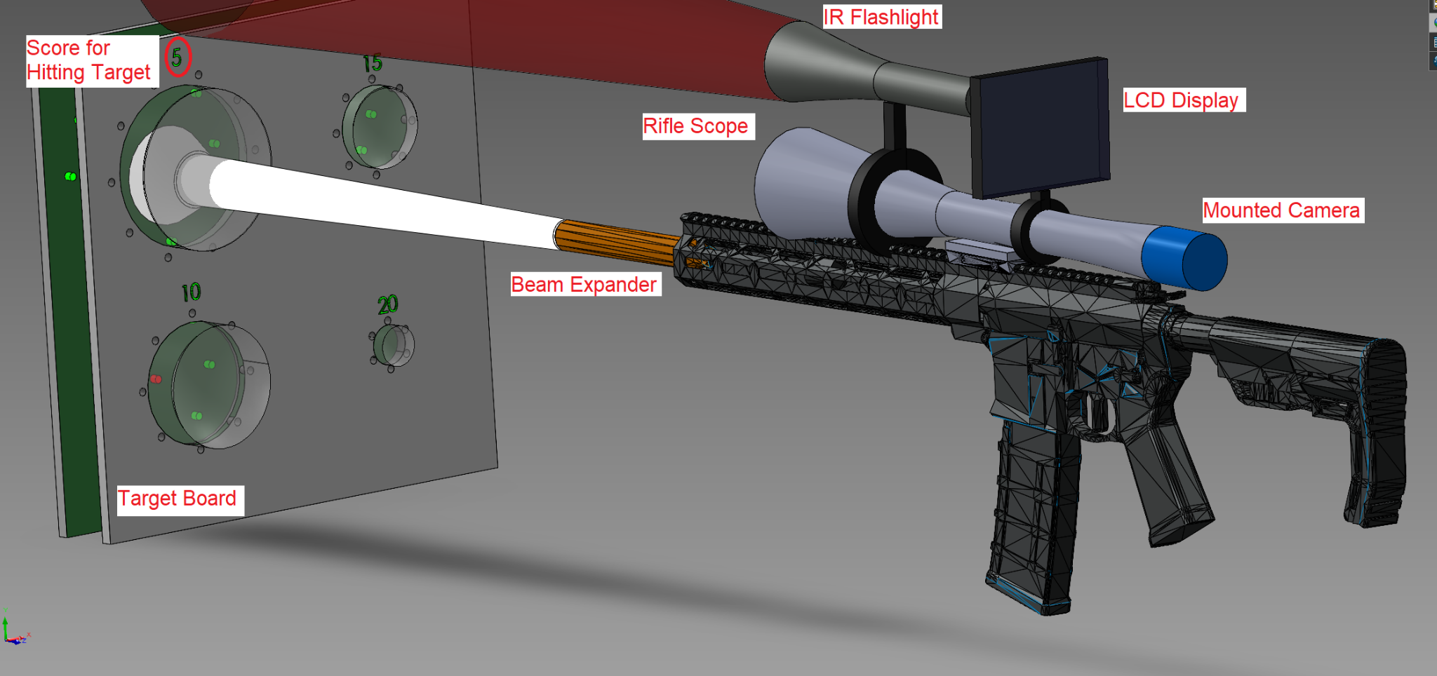
Rifle Scope Implementation
Cameron Vo
Optical Engineering
Entirely 3D printed
Night vision setup can be removed
Scope with and without night vision
Full System Interaction
Notes:
Cameron Vo
This is the preliminary design for how we plan to create the rifle scope and how it would look mounted onto the rifle. It will need to be printed in multiple pieces since the scope will be too long to fit on the 3D printer bed. The scope, as well as the additional night vision components, will be able to be mounted and removed as needed

Slide 16
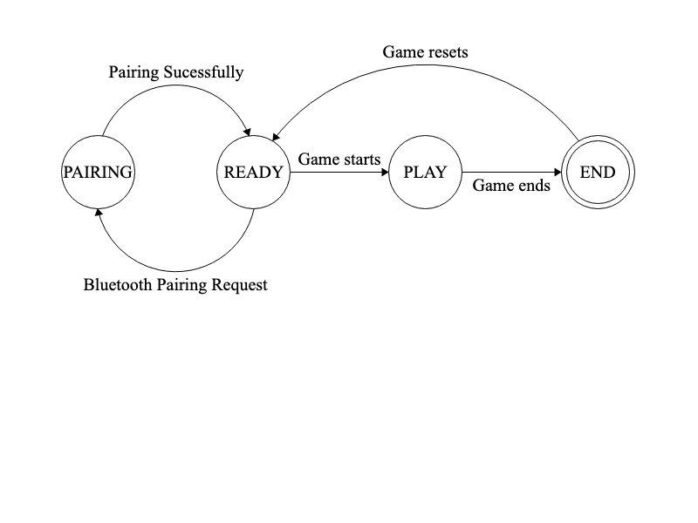
System Features Design
The system will be event-based.
Using a Finite State Machine for illustration:
Quang Pham
Computer Engineering
Laser Rifle and Target Board MCU State Machine Diagram
Notes:
Quang Pham
We choose the Finite State Machine illustration for our system. Here there are four states: PAIRING, READY, PLAY and END denoted by circles. Each state takes some type of input representing a transition arrow, and then outputs the result from one state to another followed by another transition arrow.
The PAIRING state is a start state where the Laser Rifle and the Target board begin the pairing request with the mobile application, connecting and communicating with each other. Once the pairing is established, it shifts its state to the READY state the system is awaiting for user input or new instructions while maintaining consistent connections. On the mobile application, the user chooses the gameplay mode, and then the system will switch to the PLAY state indicating a game is currently running.
If the game event has come to an end or is being interrupted somehow, then the system will switch to the END state which is also known as the accept state, denoted graphically by a double circle.

Slide 17
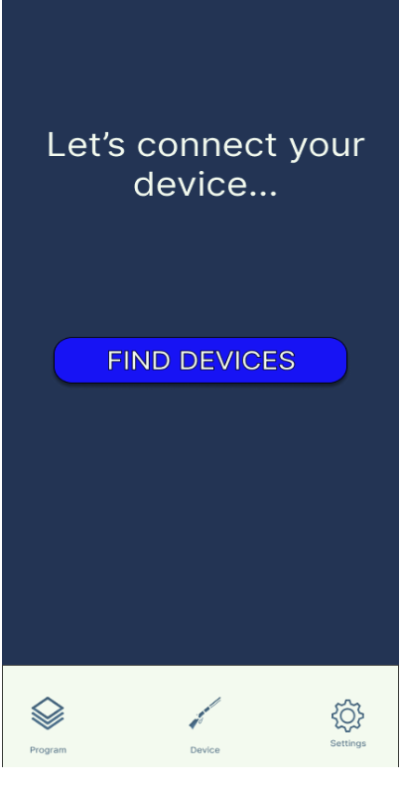
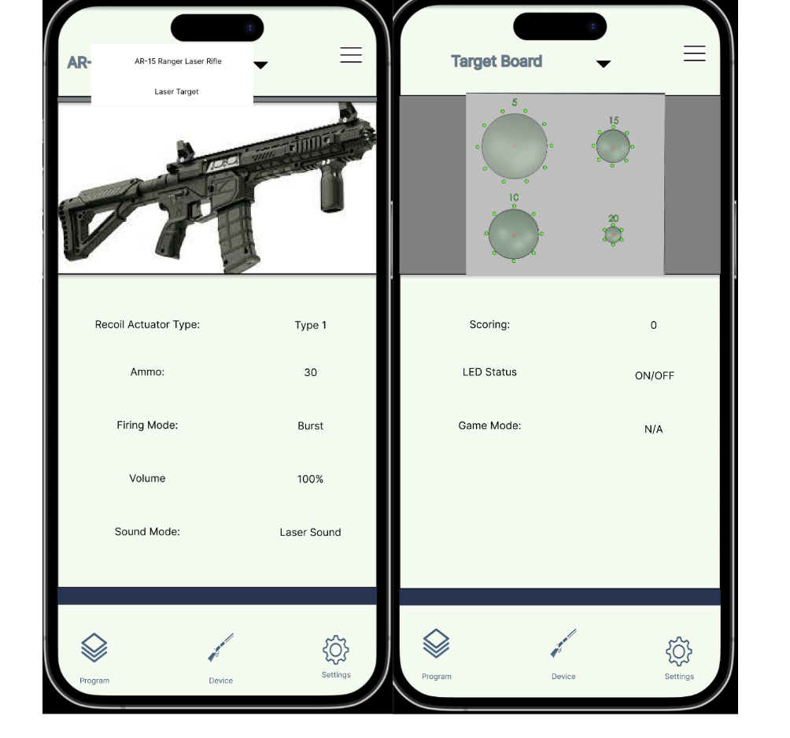
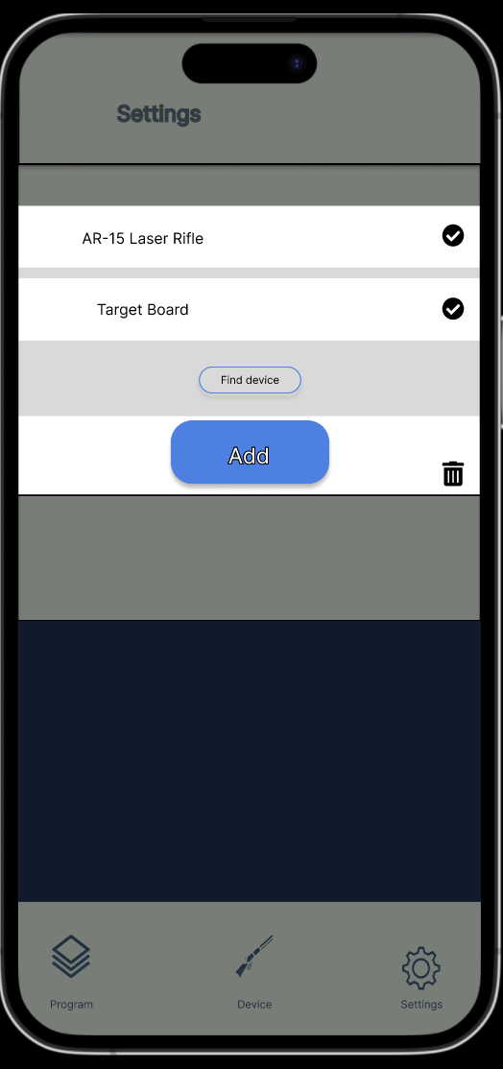
Mobile Application User Interface Design
Quang Pham
Computer Engineering
Notes:
Quang Pham
Here is a glimpse of our mobile application user interface. The app will begin its first time setup with FIND DEVICES page as shown on the left. Then once we have connected a device through Bluetooth, we can see the device dashboard with all of its current configuration..
User can modify the Rifle or the Target setting by changing values of each config, and press the confirm button to save the setting. The app will communicate with the device and transferring the data to the Rifle or the Target board through the Bluetooth technology.

Slide 18
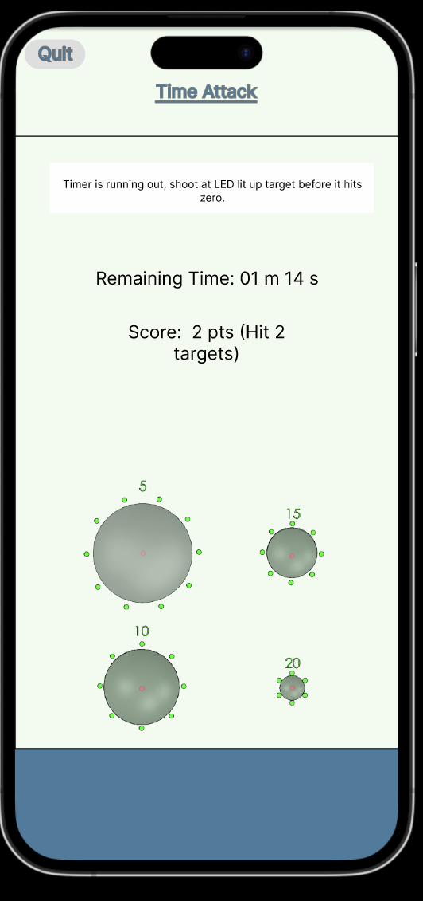
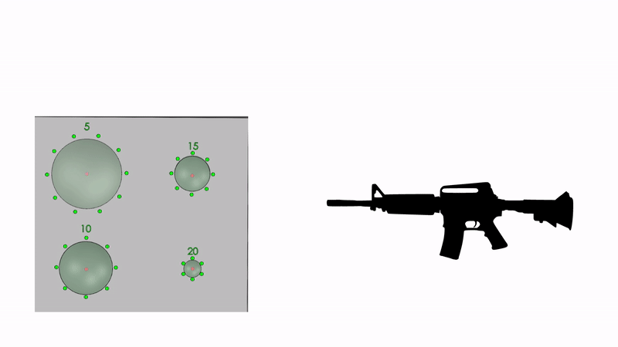
Game Mode Explained: Time Attack
The PLAYER choose a preset timer and start the game.
A pattern of LEDs lit up on different Target Board
The user will need to shoot at each of those lit up LED to score before timer runs out.
Accurate shot to Target will reward them a score.
Quang Pham
Computer Engineering
Notes:
Quang Pham
As our main goal of this project was about simulating a shooting range experience and training gun safety, we also come up with three different game modes for a fun and active experience with our tech.
Our first game mode is Time Attack. The player will choose the preset timer on the Mobile Application. And then there is a pattern of Standby LEDs light up. The player must shoot the correct Target to score. A correct Target shot will reward them a score. An incorrect shot will not reward a score. After the timer hits zero, the game will stop and the user can viewed the final score on the app and the target display.

Slide 19
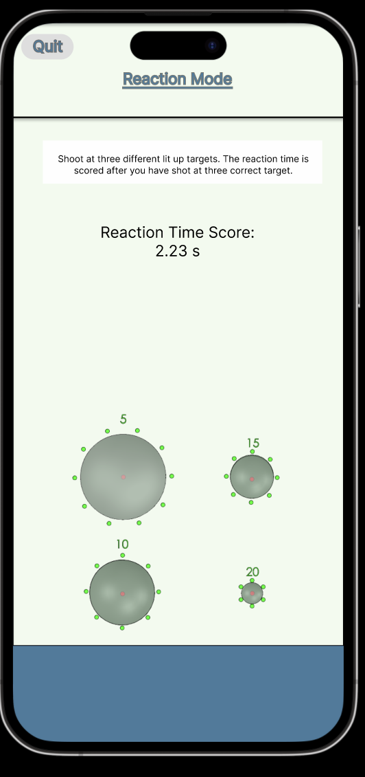
Game Mode Explained: Reaction Mode
The PLAYER press the START GAME button on the app.
When the game begins, three random Target Board LEDs will light up.
Player need to shoot accurately at these three random Target Board.
The game ends after all three Targets are hit.
Quang Pham
Computer Engineering
Notes:
Quang Pham
Our next game mode is the Reaction Mode.The animation is just an example and does not accurately demonstrate the execution, but it’s a perspective of the main idea for our team to develop. So, the PLAYER will press the START GAME on the app. When the game begins, Three different Target’s LED are triggered. Then, the Timer will start counting. The user must be quick and accurately hit all three lit Targets to end the game. The Reaction Time Score will be shown after the game is over. If the user did not hit the target accurately, the Target will stay lit until the user hits it accurately.

Slide 20
Game Mode Explained: Score Attack
Similarly to the Time Attack game mode..
Four Target LEDs are lit up in a pattern
Player will need to shoot at those targets multiple time to SCORE.
Quang Pham
Computer Engineering
Notes:
Quang Pham
Our last game mode is called Score Attack. So basically all four Targets LED are lit up. The PLAYER can accumulate points by shooting at any Target multiple times and accurately before the timer of the Target controller reaches zero. The Target that has less points (i.e. 5 pts Target) will require fewer shots than the Target that has most points (i.e. 20 pts Target). If the user did not hit the lit up LED target, there will be no score, as shown in the animation. The Target LED switches to OFF state after the number of shots has been reached, and after 2 seconds, the Target LED switches to ON again and can be shot at it again. When the timer reaches zero, the game is over, and the final Score will be shown to the user on the mobile application.

Slide 21
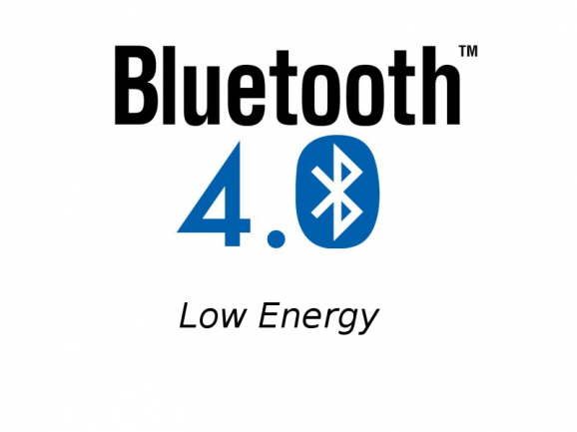
Bluetooth Connectivity:
Quang Pham
Computer Engineering
Bluetooth 5.0 | Bluetooth 4.0 / Bluetooth LE
Lesser power consumption | Good power consumption
New technology | Old technology
Multi-point connectivity | Single device
Maximum range 800 ft and 50 mbit/s speed | Maximum range 200 ft and 25 mbit/s speed
VS
Notes:
Quang Pham
We choose the Bluetooth technology as our main data communication between the device and the mobile phone. So We decided on the version 5.0 because it’s a newer technology and has newer features. The advantage of this new technology is the increased range, speed, and data capacity. The wireless connection between the two devices are 800fts, which is far enough for us. It’s necessary because we can have a less power consumption and configure the device at further range. This is one of our main goal during the designing phase..
Alternatively to Bluetooth 5.0 is the Bluetooth LE, aka Bluetooth 4.0. The advantage of the newest versions of Bluetooth 5.0 is that it can help our devices to consume lesser power compared to Bluetooth 4.0. The technology also has a new feature that is called multi-point connectivity which allows multiple devices to be connected to one device at once. Bluetooth LE has a smaller range, which is shown to have maximum range as 200 ft, and lesser transmission rate speed.

Slide 22
Microcontroller Requirements
Bluetooth functionality
≥ 20 GPIO Pin connections
Clock Speed ≥ 50 MHz
Low power / power saving mode
David Johnson
Electrical Engineering
Notes:
David Johnson
Here we have our microcontroller requirements and specifications that we found necessary when searching for a microcontroller for our system. One of the main things we were looking for in a microcontroller was bluetooth/wifi functionality without the need of an external module. Currently in our system we have decided to use bluetooth to connect our rifle and target to the phone application.
For our microcontroller we also wanted to insure we had plenty of pin connections for our current hardware and any future hardware we may add later on.
A high clock speed is important to us so that it can perform operations quickly at a low price.
A low power mode is important so the laser gun is ready to be turned on at the flip of a switch. Low power mode is also useful for bluetooth so that the device is always discoverable by the phone application.

Slide 23
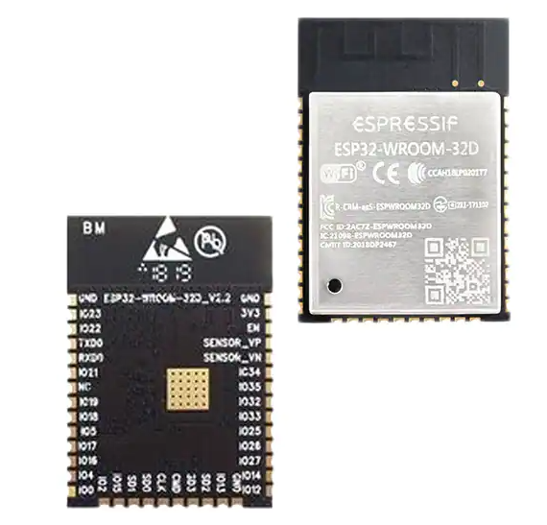
Microcontroller Selection
David Johnson
Electrical Engineering
Company | Arduino | Texas Instruments | Espressif Systems
Microprocessor | ATmega2560 | MSP-EXP430G2 | ESP32-WROOM-32-N4
Operating Voltage (V) | 5V | 1.8V – 3.6V | 2.7V – 3.6V
Current Draw (mA) | 40 | 1 | 500
Bluetooth (Stock) | No | No | Yes
Wi-Fi (Stock) | No | No | Yes
Clock Speed | 16 MHz | 16 MHz | 80 - 240 MHz
Availability | Available/Own | Available/Own | Available/Own
Notes:
David Johnson
This section shows how we selected and decided on which microcontroller to use for our project. We researched and looked at many microcontrollers before finding just three that we were interested in. We were already familiar with the Arduino and Texas Instruments boards from prior projects and course work which made them viable options. However, as you can see the ATmega and MSP430 don’t have the option for Wi-Fi or bluetooth functionality without adding an additional module. We chose the ESP32-WROOM for it’s bluetooth functionality, compact design, and processing power. We will use the ESP32 controller on both the laser gun and the target system.

Slide 24
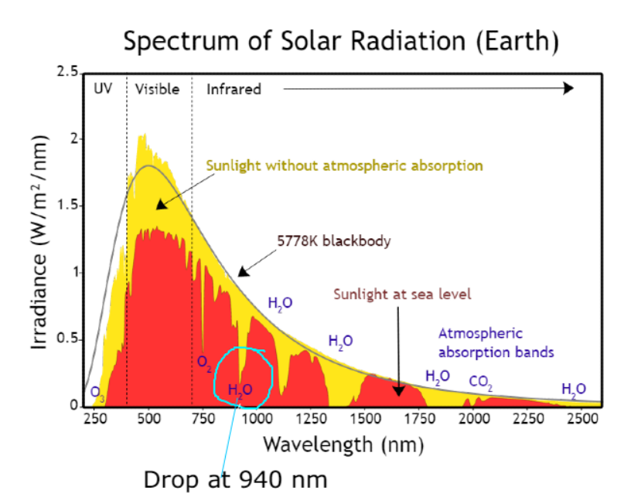
Wavelength Selection
In deciding wavelength, we considered the:
Least amount of optical noise
Compatibility with commercial photodetectors
Ability to find low-power laser diodes
Cost of related components
We chose 940 nm as the wavelength
Cameron Vo
Optical Engineering
Notes:
A major part of our project is determining the wavelength we wanted to work with. Since we want to work outdoors, a wavelength where there is the least amount of optical noise possible is ideal. We also need to be able to find photodetectors that are made to detect the wavelength. We will also need a low-power laser diode that emits at the desired wavelength. Finally, all of these components need to be well-priced. As you can see in the image, optical noise is much less common at 940nm and these components can be easily found on the market for quite cheap, so we picked 940nm as our laser wavelength

Slide 25
Laser Diode Selection
Cameron Vo
Optical Engineering
There are not many low-power 940 nm laser diodes available
RPMC Laser VD-0940C-008M-1C-410 ($13 each)
940nm 8mW VCSEL diode
3.5mm x 3.5mm x 3.5mm in size
Built-in Collimating lens (<10 mrad divergence angle)
Since laser power must be <5mW, we can use:
Uncoated lenses for beam expander
Apertures
Reduces spot size for more accuracy while cutting optical power
Notes:
For this wavelength, there are not many low power laser diodes available, so there is not much room for comparison. We got the RPMC laser 8mW VCSEL diode which comes with a built-in collimating lens in a very small package. Since our requirements are that power must be below 5mW, we can drop power using blocking apertures and using uncoated lenses in the beam expander to decrease transmitted power

Slide 26
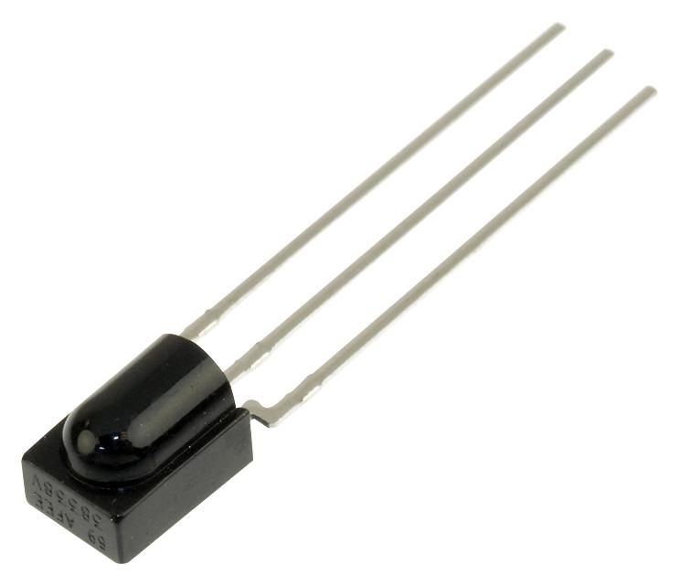
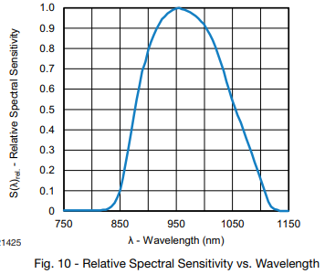
Photodetector Selection
We chose to use IR receivers, which are photodiodes that:
Only detect modulated light
Effective countermeasure against optical noise
Output a digital voltage signal upon receiving signal
Vishay TSOP98638 IR receivers ($0.72 each)
Reacts to 940nm light modulated at 38 kHz frequency
Can detect as light as weak as 0.12 mW/m²
Outputs 0.3V signal in response
370 μA supply current
Cameron Vo
Optical Engineering
Notes:
We chose to use IR receivers, which are photodiodes that only detect modulated light. This makes them useful for suppressing optical noise. Instead of outputting a photocurrent, the receivers output a digital voltage upon detecting the modulated light. We will use Vishay receivers that are made to detect to light modulated at 38kHz, outputting a 0.3V digital signal in response. We specifically chose this model because it has a low power drain with only 370uA supply current

Slide 27
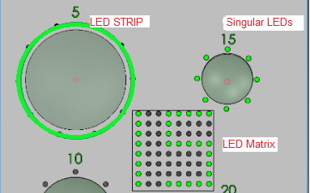
Target Board LED Selection
Eltholad Orelien
Electrical Engineering
Still deciding on a couple of different options
Singular LEDs
Ideal but may be difficult to implement/set up
LED Strips
Pre-made, but energy may be wasted due to high viewing angle
LED Matrix
May be challenging to program
If pre-made, same problem as strips
120 degree viewing angle
45 degree viewing angle
Notes:
We have a couple of different ideas for the LED designs, which include singular LEDs, or LED strips, and a matrix. The strips and matrix would be more convenient since we would just buy them, but the preinstalled LEDs would have high viewing angles, meaning that much of the light will be spread out over a large region. At a long distance like 15m, most of the light should be directed towards the user to avoid wasting energy, which would be avoided if we used lower viewing angle LEDs.
During Senior Design 1 we chose to use individual LED for our target board system. The idea was to use clusters of LEDs spread out on the target board and have them activate when shot at with the laser rifle. LEDs in general are a very cheap component relative to other parts in our system. LEDs also use very little power and are quite simple to hook up.
During our testing we have discussed using a programmable LED strip rather than individual LEDs for ease of installation. Currently if we use individual LEDs it will be very tedious to hook them up and ensure they all work together properly. Using an LED strip might make the process easier since they will be in series with one another and give a nicer overall look to our target boards. The LED strips we have looked at are either 12V or 5V and our microcontroller outputs 3V, so we know we will need a level shifter to ensure the LEDs run at the proper voltage.

Slide 28
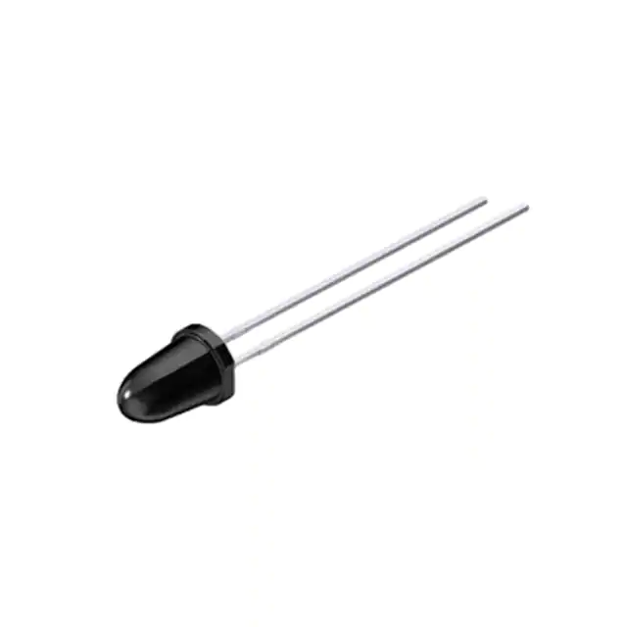
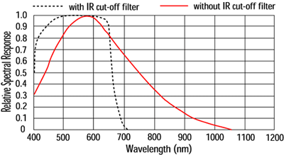
IR Flashlight LED Selection
Only needed to worry about the optical power and wavelength
Flashlight lens system will change the angle of the light
Wavelength must be detectable by CMOS camera
Osram Opto SFH 4555 ($0.49)
860 nm Through Hole LED
550mW/sr @ 100mA
Eltholad Orelien
Electrical Engineering
CMOS Spectral Sensitivity
Notes:
The IR Flashlight LED was decided based on the optical power and wavelength. Unlike the target board, viewing angle isnt as important since the flashlight lens system will change the angle of the light. So we needed a strong LED that the CMOS camera would be able to detect. We got the Osram Opto LEDs which are incredibly powerful

Slide 29
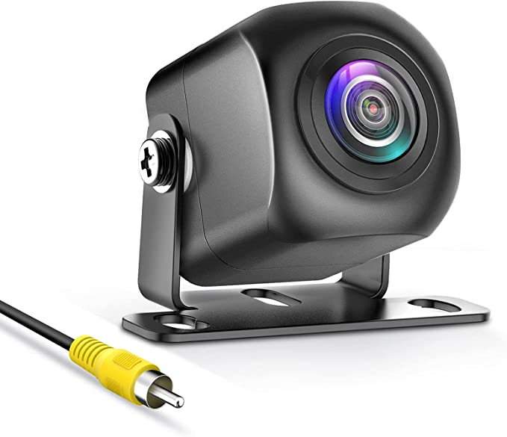
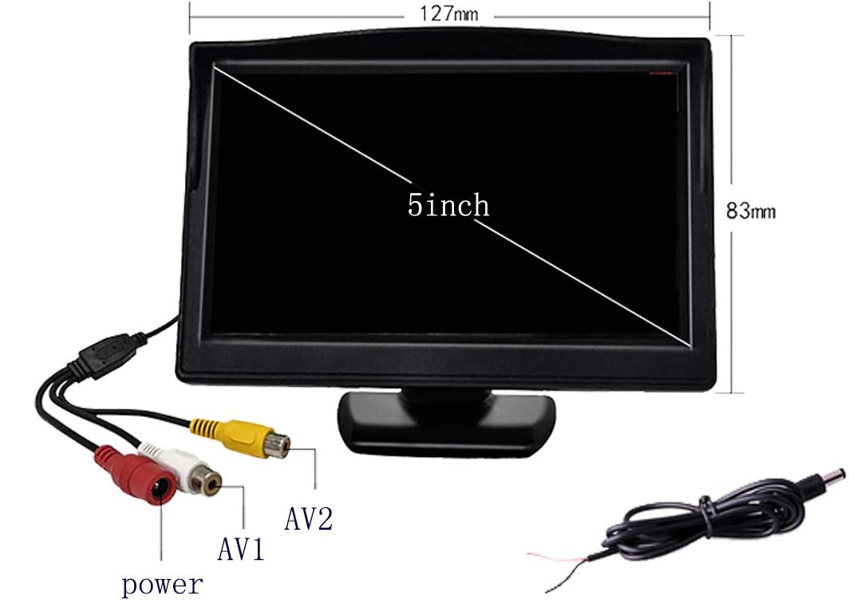
CMOS Camera and LCD Display
We used analog video transmission
Digital requires extra computing device (Raspberry Pi) just to send video
Needed best image quality, no IR filter, and good light gathering
PixelMan PMD2A Camera ($40)
F/1.4 lens system and 1/2.7 inch color CMOS designed for low-light
1080p with 170 degree FOV
Padarsey 5 inch TFT LCD Color Monitor ($25)
Eltholad Orelien
Electrical Engineering
Notes:
We chose to use analog video transmission since digital would require us to get a separate computer like a Raspberry Pi just to send video to the LCD display. For the camera, we looked for the best image quality, ability to see Infrared, and good light gathering capabilities. We got the Pixelman Camera which outputs 1080p video and is designed for light gathering. For the LCD display, we narrowed down our results based mainly on the size since it would need to be portable while being large enough to look at comfortably

Slide 30
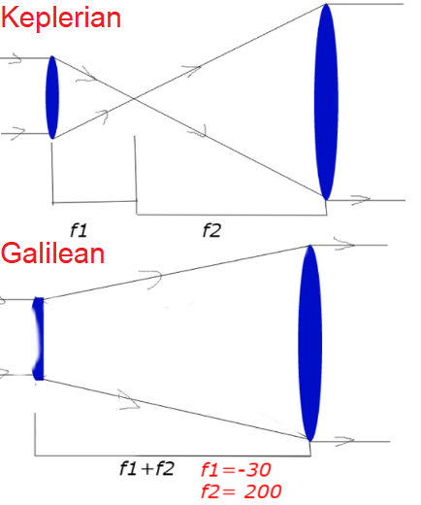
Beam Expander
Cameron Vo
Optical Engineering
Increases the spot size of the laser
Decreases the divergence angle of the collimated beam
The smaller the angle, the longer the range the rifle can be used
Galilean design
Less space than using two positive lenses (Keplerian)
-30 EFL Planoconcave and 200 EFL Biconvex
6.67x Spot size increase and 85% decrease in divergence angle
Notes:
The beam expander works to proportionally increase the spotsize of the laser while decreasing the divergence angle of the laser beam. Decreasing the divergence angle means the rifle can be used at longer ranges. Since the amount of space we use is important in our project, we used the more compact galilean design with a planoconcave and biconvex lens that increases spot size by 6.67 times but decreases divergence angle by 85%

Slide 31
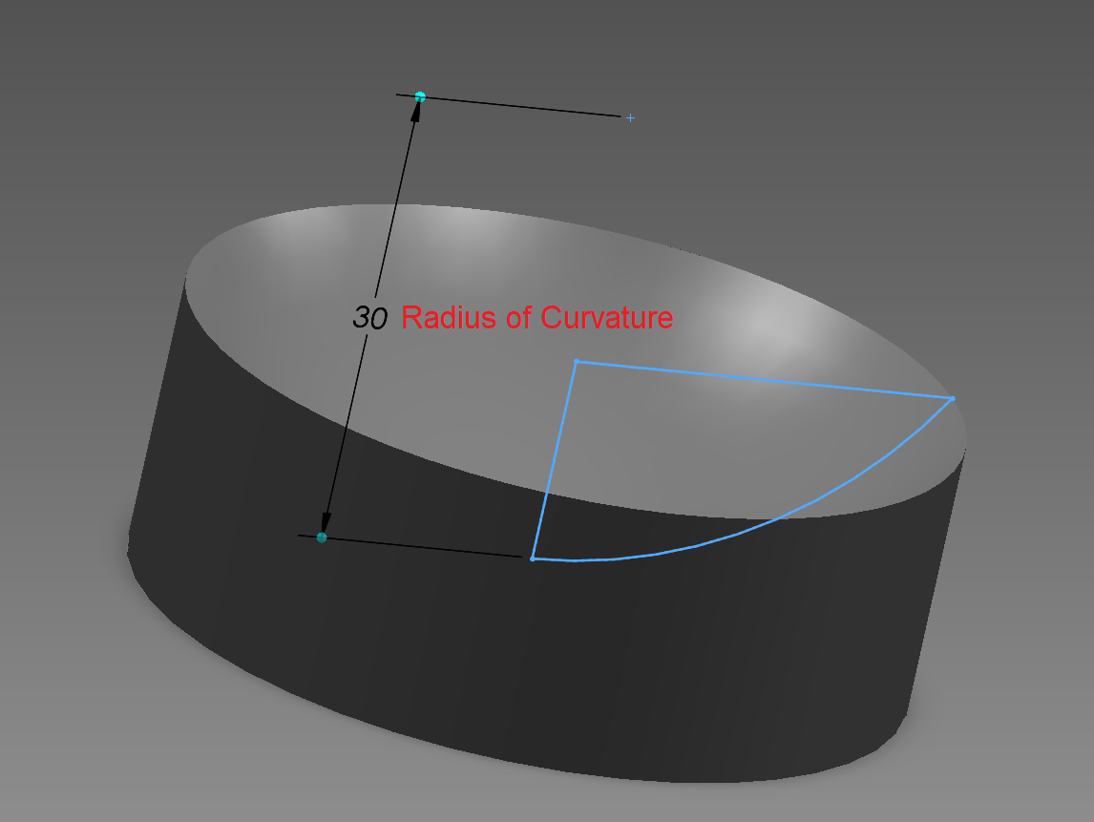
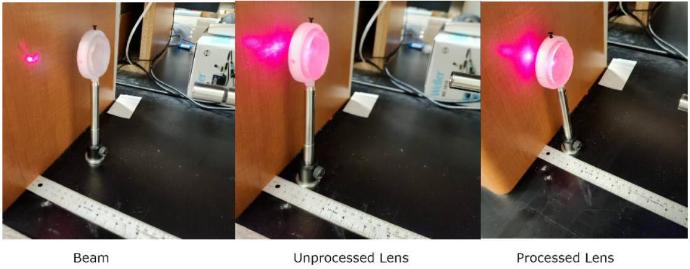
Target Board Lens System
Cameron Vo
Optical Engineering
3D Printed PETG Plano-concave lenses
~50% transmission
Expands all incoming light through bending and scattering
Significantly reduces optical noise
Laser beam expands, reducing amount of IR receivers needed in a target area
Concept
Solidworks Model
Testing
Notes:
The target board lens system uses 3d printed PETG plano concave lenses. These lenses will be processed using polishing and sanding equipment. Our tests show that they have a 50% light transmission after processing. They work by expanding all incoming light through bending and scattering since they are not perfectly transparent. This will reduce optical noise further and expand the laser beam such that we will need less ir receivers in the system.

Slide 32
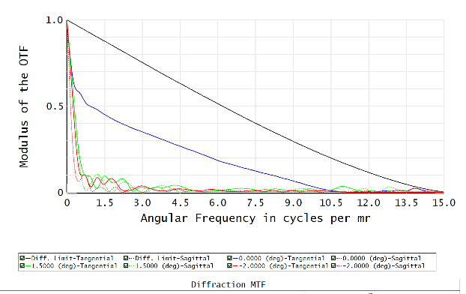
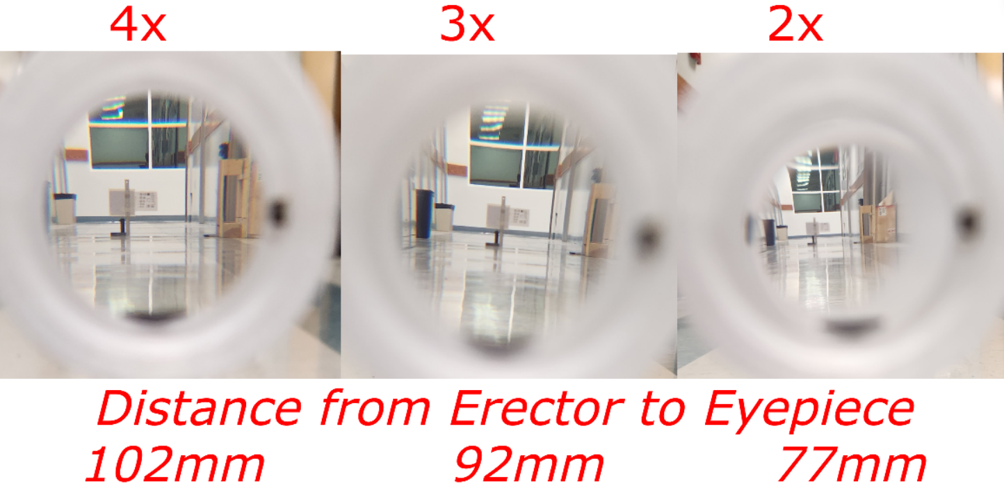
Variable Power Rifle Scope
Cameron Vo
Optical Engineering
Scope erector lens assembly moves to alter image magnification
Collimated and aberration corrected at 4x zoom
Zemax angular resolution is 0.125 mrad
Experimentally tested to be 0.135 mrad
Light Transmission measured at ~80%
Zemax Simulation
MTF
Magnification Test
Notes:
The rifle scope will include a moving erector assembly that alters the magnification of the scope. However, the scope is optimized to have the best image at 4x zoom with a theoretical max angular resolution of 0.125 mrad, although our experiments have shown it is 0.135 mrad. At 4x zoom, the scope has exit pupil parameters that are similar to that of rifle scopes sold commercially The light transmission through the system is around 80%.

Slide 33
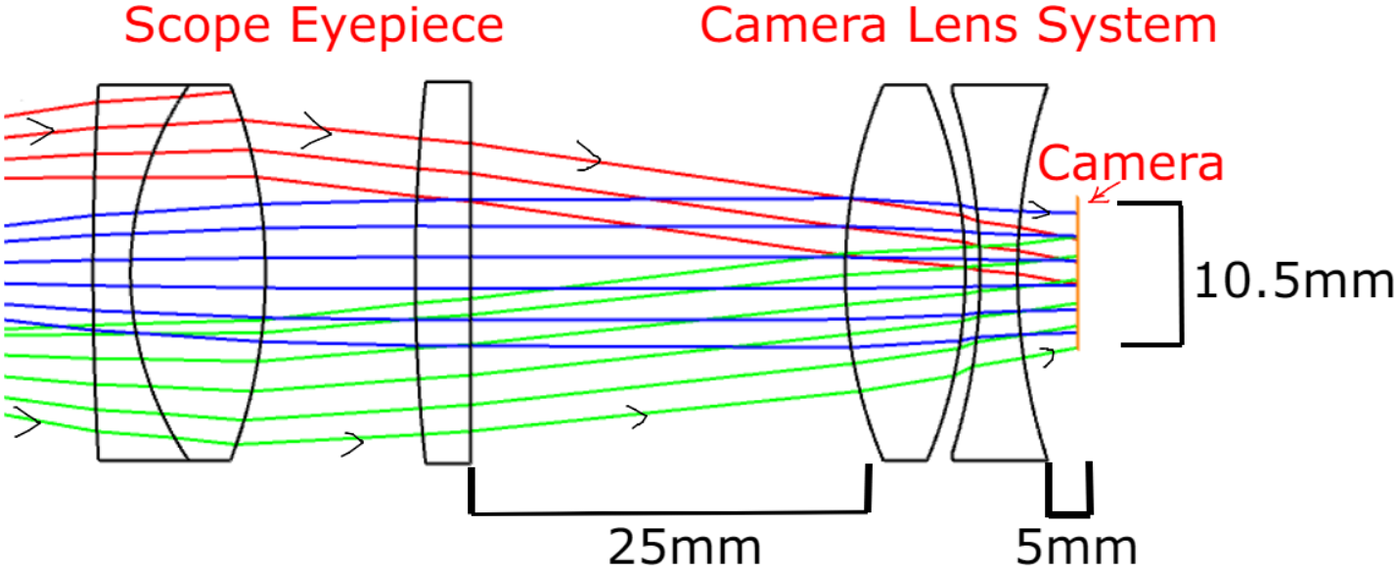
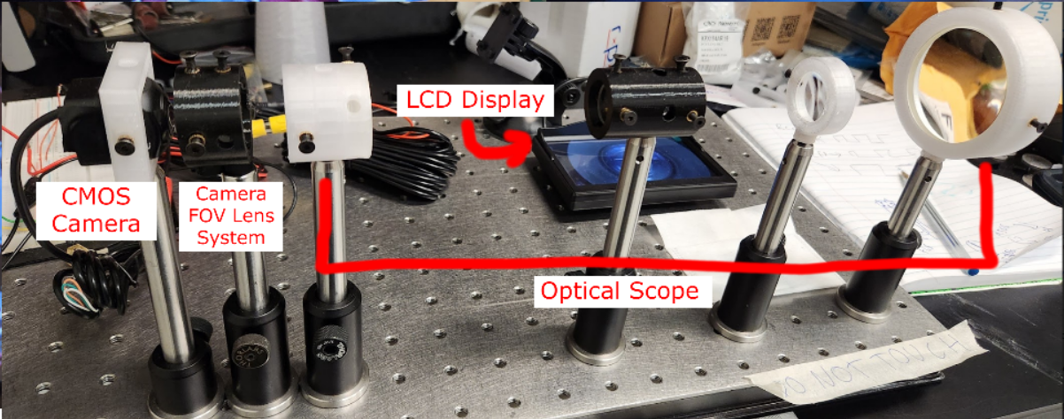
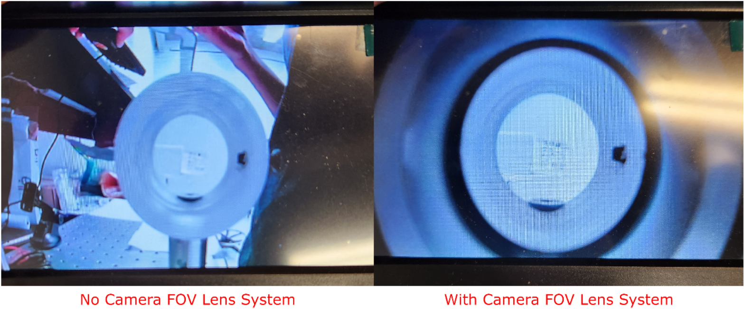
Camera FOV Lens System
Default Camera FOV is 170 degrees
Much of the image is wasted
High power Biconvex + biconcave lenses
Magnifies image while decreasing FOV to 110 degrees
Not great, but tests showed that decreasing FOV further can degrade image
Cameron Vo
Optical Engineering
Zemax Simulation
Test Setup
Testing
Notes:
The camera FOV lens system works to increase the amount of usable image outputted by the camera. Since the FOV of the camera is 170 degrees, much of the image is wasted as shown in our tests. By using a combination of a biconvex and biconcave lens, we magnify the image and decrease FOV to 110 degrees, which admittedly isn’t great, but decreasing FOV any further made the image far too blurry to use

Slide 34
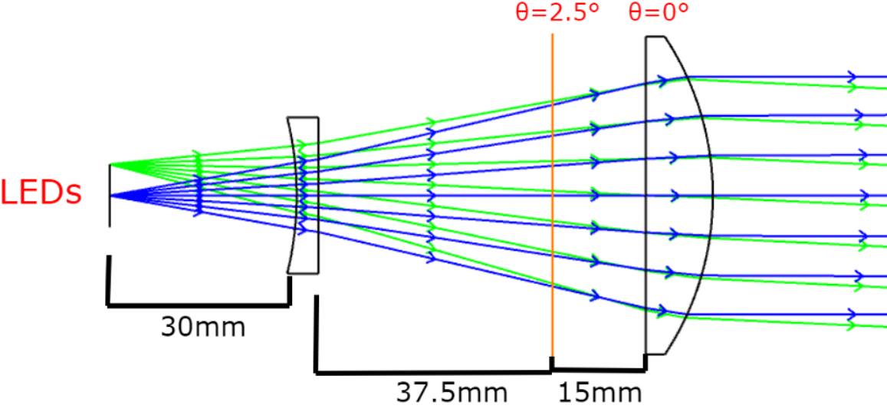
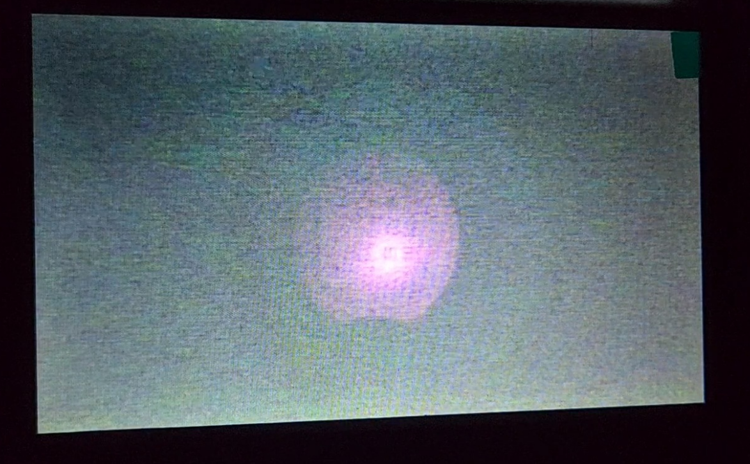
Variable Focus IR Flashlight
Cameron Vo
Optical Engineering
Planoconcave combined with planoconvex lens
Compact design
Max axial length is 82.5mm
Planoconvex lens moves to precisely adjust divergence angle (0-2.5 deg)
Zemax Simulation
IR LEDs seen using scope+camera
Notes:
Finally, the last optics design is the variable focus IR flashlight. The IR flashlight will combine a planoconcave lens with a planoconvex lens. The planoconvex lens moves back and forward to precisely adjust from a 2.5 degree half angle to emitting collimated light. The overall design for the flashlight lens is compact and portable and seemed to work well in the tests we have performed

Slide 35
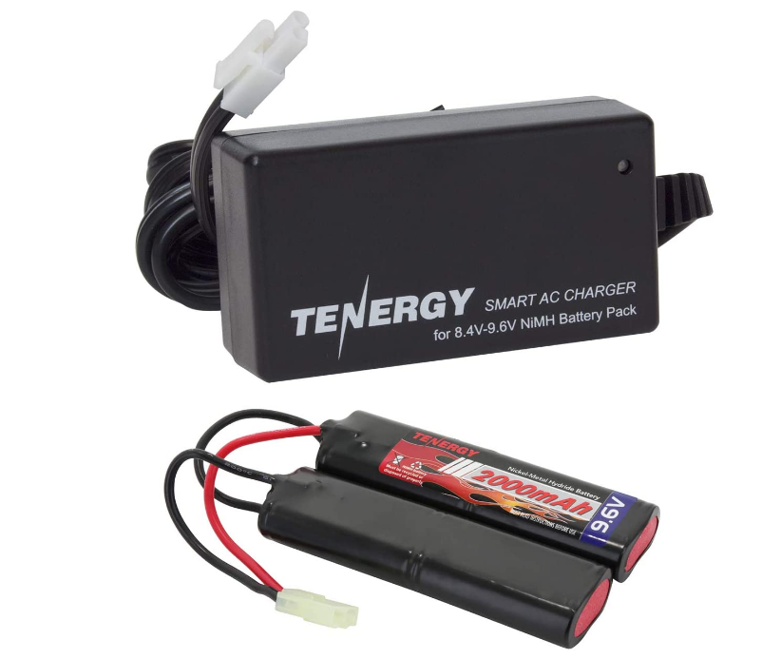
Battery Selection
Rechargeable 9.6VDC - NiMH ($17)
2000 mAh
Common Mini-Tamiya connector type
To be regulated to 5V and 3V for MCU and main components
Advantages:
Availability
Cost
Dimensions are optimal for rifle frame
Battery Protections
Eltholad Orelien
Electrical Engineering
Notes:
Eltholad Orelien
Since our project is mobile, spacial limitations and energy density were prioritzied
Due to reliability and performance we Originally searched for Li-ion batteries but to no avail due to pricing and availability
Forced us to look towards Nickel Metal Hydrite supplies despite lower performance so we purchased a 9.6V supply with max current of 2000 mAH from Tenergy
Also Since our project involves a rifle frame it required a battery design that would fit inside said frame while still providing a fair amount of power and this nunchuck design and dimensions were perfect for doing so
Also the provided voltage is high enough that boost converters will not be necessary thus avoiding efficiency penalties
It also provides overcharge, Over voltage and Over current protection

Slide 36
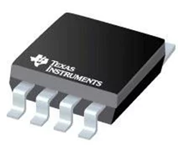
Voltage Regulator Selection
Eltholad Orelien
Electrical Engineering
Regulators used UA78M and TL2575
Laser rifle and Target board will contain both regulators 5V
Model | Nominal Vout (V) | Output current (mA) | Price
TPS76333 | 1.6 - 5V Variable | 800 | $0.71
UAM78 33CDCY | 3.3V | 500 | $1.36
UA78M05IKVURG3 | 5v | 500 | $0.91
TL2575-05IKTTRG3 | 5V | 1A | $1.32
Notes:
Eltholad Orelien
For our power system selection we looked to have the combination of 3.3V and 5V regulators since both the target and rifle will be utilizing the same battery in their systems. In the beginning we choose both UA78M regulators one 5V and one 3V since both were cheap, had design similarity and provided a decent output current of 500mA. However later we found the TL2475 regulator to replace the 5V regulator which provided twice the current output and reverse bias protection.

Slide 37
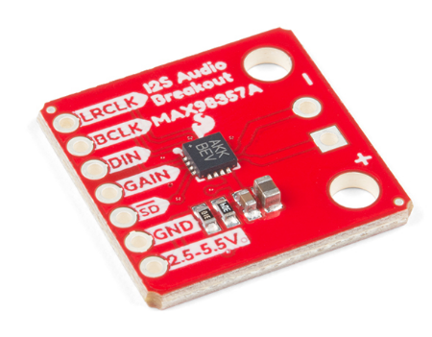
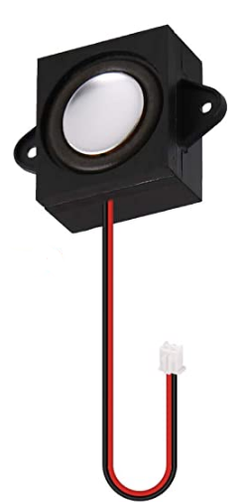
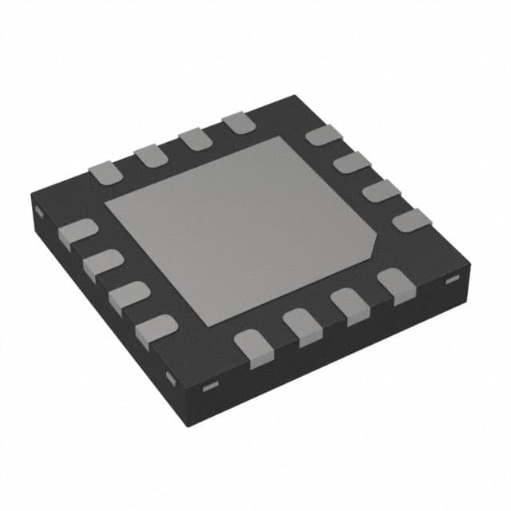
Audio Selection
Eltholad Orelien
Electrical Engineering
Audio Amplifier Chip
SparkFun I2S Audio Breakout - MAX98357A
The gain of the amplifier can be configured from as low as +3dB to as high as +15dB
Speakers
Chip required maximum power 3.2 Watt and rated impedance of 4Ω
Found MakerHawk 4Ω 3-Watt Speaker
Notes:
Eltholad Orelien
To keep the audio design simple we found the SparkFun I2S Audio Breakout board that allowed us to test the MAX9835A Audio amplifier chip with ease. The chip itself requires few pin connections and after testing in Senior Design 1 found that when paired with a speaker with the listed power and impedance requirements provides a sufficient audio experience.
Now that the audio chip and device speakers have been tested, we now only have to integrate just the audio amplifier chip not without the breakout board to our systems PCB designs.

Slide 38
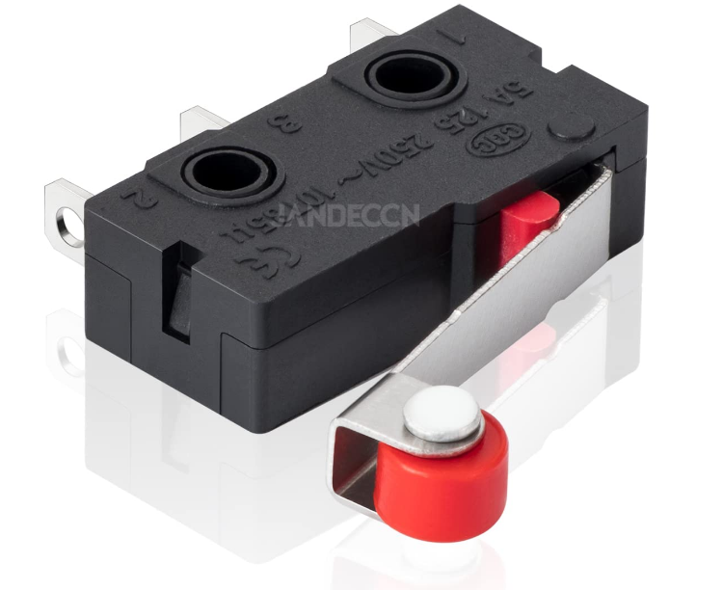
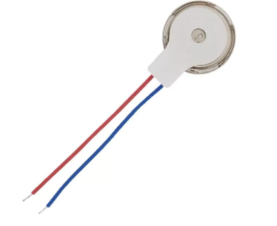
Trigger & Vibration Motor
Vibration Motor
5V Parallax Vibration Motor 28821
Activated by MCU when trigger is pulled
Eltholad Orelien
Electrical Engineering
Trigger
JANDECCN Limit Switch SPDT Hinge Roller Lever
Used as the laser activation signal and reload function
Notes:
Eltholad Orelien
In order to successfully simulate a rifle, a trigger is necessary. We have decided to go with the JANDECCN Limit Hinge Roller Lever Switch rated for 5 Amps 250V due to its easy use and high availability. Once pulled it will signal the MCU to drive the laser. The same switch will also be used to implement a physical reload function for the rifle.
To simulate haptic feedback we will be using the 5V Parallax Vibration motor. Once the MCU is signaled to drive the laser it should simultaneously activate the motor.

Slide 39
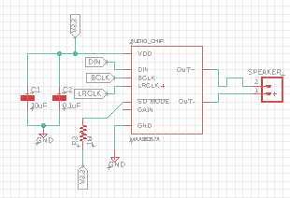
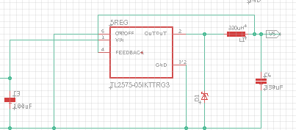
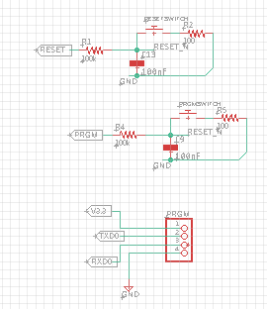
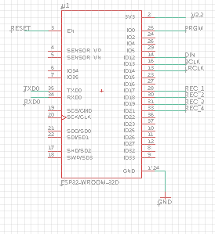
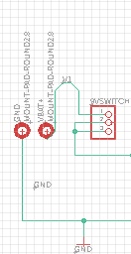
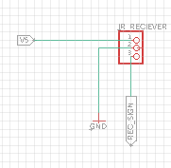
Target Schematics
Eltholad Orelien
Electrical Engineering
3.3V Regulator
Audio Chip
5V Regulator
Battery & On/Off
Programming Buttons/Pins
ESP32 w/Connections
IR Receivers & Pins
Notes:
Eltholad Orelien
Here is an overview of our schematic for the target. We have ESP32 with its current connections, IR receiver and nodes, buttons for reset and programming, the On & Off switch with battery placement holes, 3.3V and 5V regulators and lastly the audio chip. One thing that is currently missing is the addition of our LED hit indication. Reason being that we have 2 options that we are currently testing and are looking for the most beneficial implementation.

Slide 40
Rifle Schematics
Eltholad Orelien
Electrical Engineering
Programming Buttons & Pins
Battery connection/Switch & Regulators
Audio Chip and Speaker
Laser, Trigger, Reload and Vibration Motor
ESP32 & Pin connections
Notes:
Eltholad Orelien
This is an overview of all our schematics for the Rifle. As you can see for simplicity purposes the design is fairly similar to the target. Again We’ve got the ESP32 and all its connections including its programming pins and buttons, we’ve got the audio chip and 3.3V and 5V regulators. However the difference is in the addition to the Laser, Laser trigger, vibrational motor, and reload switch.. We are currently waiting for both boards to begin assembly and testing.

Slide 41
Financing Plan
All costs will be split equally among the four members of the group
No firm budget restrictions
Generally want to try to stay under $1000 in expenses
Early estimates put the final cost at around $600-$900
David Johnson
Electrical Engineering
Notes:
Our financing plan is so that all members will split the cost evenly. We did not have any firm budget restrictions, but we generally wanted to avoid going over $1000 in cost. When planning, we expected to pay around $600 to $900 total

Slide 42
Bill of Materials
Item Type | Expected ($) | Actual ($) | Quantity
Rifle Frame | 100 | 230 | 1
IR Laser Diodes | 75 | 150 | 10
Visible Laser Diode (no longer being used) | 20 | 12 | 30
Lenses | 300 | 100 | 30
CMOS Camera | 50 | 40 | 1
LEDs | 40 | 30 | 100
3D Printer Clear PETG 3D Printer Black PLA | 100 | 40 17 | 2 1
IR Receivers | 40 | 18 | 25
Batteries | 60 | 17 | 2
Speaker | 10 | 9 | 2
PCB | 40 | MISC | 5
MCU MCU Dev Board | 16 16 | 8 16 | 2 2
Vibration Motors | 10 | 13 | 15
Misc. Components | 40 | MISC | MISC
Total | $917 | $700+MISC
Notes:
This is our overall project design budget. The table includes the money we have spent so far for our project design as well as prototyping such as the MCU development board. For most of the components in our project we bought more than we thought we would need to ensure we had enough components for testing as well as final implementation.
Our total amount spent so far is $700 which is less than the amount we expected to spend. We included a Miscellaneous components section to account for any changes, problems, or redesigns we might run into.

Slide 43
Difficulties during Development
Laser Diode
Needs a reflow soldering machine to work properly
Hand soldering led to improper functioning
Bluetooth
Making Bluetooth servers did not work
Devices could not be detected
Configuring rifle/target settings through the app still WIP
David Johnson
Electrical Engineering
Notes:
We have had some difficulties during development. One was with the laser diode, which was mainly because we needed access to a reflow soldering machine in Senior Design I, which should no longer be a problem. We have had some issues with getting the Bluetooth to work properly where devices could not be detected using the smartphone app. We are also still having some struggles working on sending changes to the rifle and target settings through the app

Slide 44
Milestones
Task | Assigned To | Progress
Hardware
Finish Testing Rifle Hardware | David, Eltholad, and Cameron | In Progress
Finish Testing Target Hardware | David, Eltholad, and Cameron | In Progress
Finish Enclosure Design | David, Eltholad, and Cameron | In Progress
PCB | David, Eltholad | In Progress
Complete Hardware Testing | David, Eltholad, and Cameron | In Progress
Software
Finishing the App User Interface | Quang | In Progress
Flashing Programming Code onto the MCU | All | In Progress
Able to Configure Devices Using the App | Quang | In Progress
Finish the Gameplay Feature | Quang | In Progress
Test Gameplay | All | In Progress
Complete Software Requirement Testing | Quang | In Progress
Administrative
CDR Presentation | All | Done
Write Conference Paper | All | In Progress
Create Website | All | In Progress
Final Presentation | All | In Progress
David Johnson
Electrical Engineering
Notes:
These are our milestones which include hardware, software, and administrative portions of our project. We use the milestones to make it easier to see what work has been completed and what still needs to be completed. We also are able to split up the work more efficiently so everyone in the group knows what they need to be working on.

Slide 45
Progress To Date
David Johnson
Electrical Engineering
Notes:
This bar graph shows our estimated progress to date including hardware, software, and administrative portions of our project design.

Slide 46
Next Steps
Hardware
Begin final layout for PCBs to fit inside enclosures
Software
Flashing programming code onto the MCU
Finish the app user interface
Pairing the app with the device successfully and retrieve data
Finish the gameplay feature
Rifle Design
Begin prototyping hardware enclosures
David Johnson
Electrical Engineering
Notes:
Hardware
Begin final layout for PCBs to fit inside enclosures
Software
Flashing programming code onto the MCU
Finish the app user interface
Pairing the app with the device successfully and retrieve data
Finish the gameplay feature
Rifle Design
Begin prototyping hardware enclosures

